Slide 1
National Conference of Vice Chancellors and Directors on Research & Innovation
UGC - Quality Mandate
Prof. D.P. Singh
Chairman
University Grants Commission

Slide 2
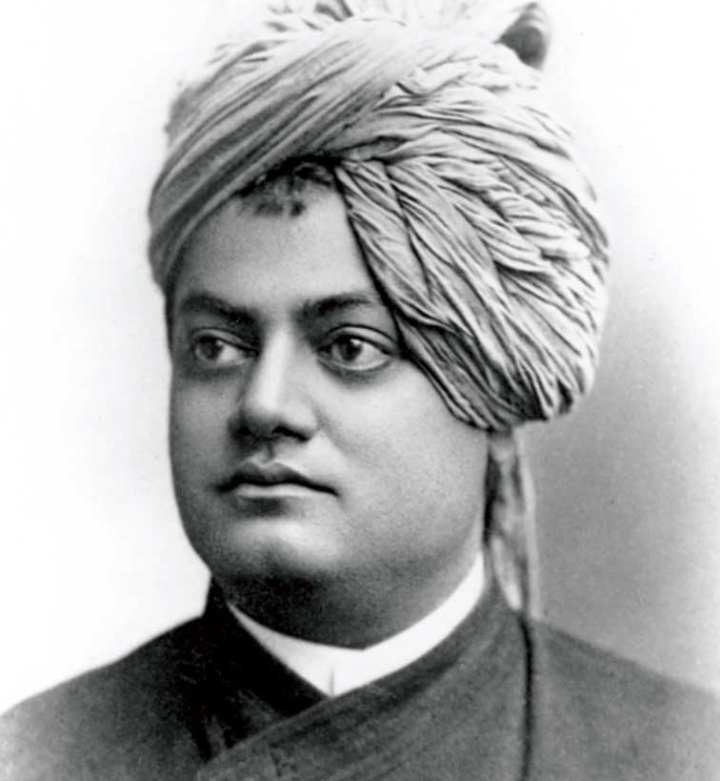

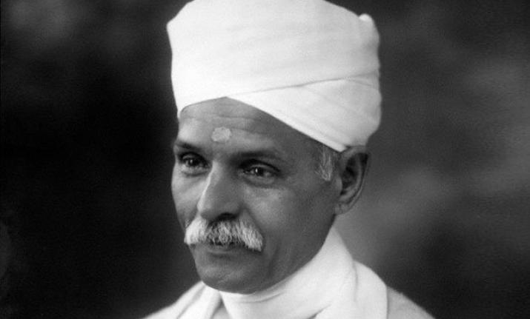
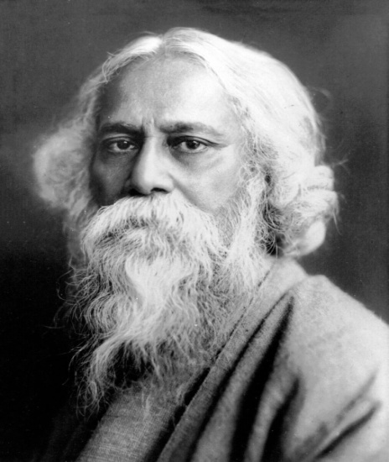
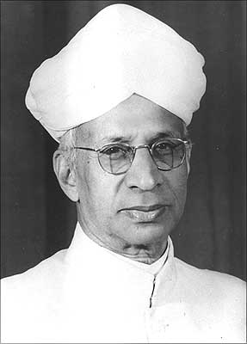
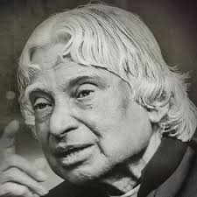
Our Role Models

Slide 3
CHALLENGES IN HIGHER EDUCATION
Achieving target Gross Enrolment Ratio of 30% by 2020
Developing intellectuals rather than just degree holders
Developing youth with environment sensitivity, human
values and professional ethics
Preparing youth for global competitiveness and
employability
Extending the reach of Higher Education (ODL, MOOCs)
Attracting and retaining qualified and competent faculty
Establishing World class institutions of higher learning
and research

Slide 4
CHALLENGES IN HIGHER EDUCATION
Enhancing the quality of academic and
sponsored research
Promoting applied research, innovation,
incubation and entrepreneurship
Motivating HEIs to participate in
accreditation, NIRF and Global ranking
Strengthening the industry-institute
interaction

Slide 5
Quality & Excellence
Quality is not achieved accidently; it always results from good intention, sincere efforts, intelligent direction and meticulous execution...
“Excellence in thinking and action is the foundation for any mission. Excellence is not by accident. It is a process, where an individual or organization or nation continuously strives to better oneself”
Dr. APJ Abdul Kalam

Slide 6
UGC Mandate for quality - targets
Improve the graduate outcomes:
  At least 50% students secure employment/self-employment or
  engage themselves in pursuit of higher education.
At least 2/3rd of the students engage in socially productive activities during their period of study
Train at least 75% of the students in essential professional skills
  Soft skills:
  innovation/entrepreneurship
  critical thinking

Slide 7
UGC quality mandate- targets
Teacher:
  vacancies at any point not exceed 10%
  100% of the teachers oriented every year - emerging trends in their respective domains and the pedagogies that translate their knowledge to the students.
Every institution shall get NAAC accreditation with a minimum score of 2.5 by 2022.

Slide 8
Initiatives
Initiatives
Social-Industry connect
Teacher Induction training
ICT based- teaching learning process
Induction programme
Learning Outcomes based Curriculum Framework
Tracking of student progress
Promoting quality research
Examination reforms
Soft skills
Mentoring of non-accredited institutions

Slide 9
Induction Programme for Students
  Focus – Orientation of New Students
  6 days Induction programme :
    Bonding and familiarization with Institution, faculty and inculcation of human values
    Concerns of students: insecurity about future, aspirations, career orientation
Activities:
  Physical Activity, Mentoring, Familiarization to Dept./Branch, Creative Arts and Culture, Literary Activity, Lectures by Eminent People, Visits to Local Area..

Slide 10
Induction Programme for Students
Action Plan and Timeline:
A guide for Induction Programme to all HEIs- Aug, 2018
Implementation- Regional workshop for teachers - Nov - Dec, 2018
HEIs - initiate action on implementation of Induction Programme

Slide 11
Learning Outcomes based Curriculum Framework
Focus - Learning and Outcomes
Achieve aims of education - knowledge, understanding, employability, soft skills, attitudes and values
Life long learning skills
Teacher centric to student centric pedagogies
Technological interventions
Subject specific curriculum templates

Slide 12
Soft skills
Focus: Personality Development
Soft skills
Social Intelligence
Communication and presentation Skills
Team work
Analytical reasoning
Critical and Reflective
thinking
Emotional Intelligence
Problem solving
Moral and ethical awareness/reasoning
Time Management

Slide 13
Learning Outcomes based Curriculum Framework
Action Plan and Timeline:
Subject specific expert committees- 37 subjects
Model Curriculum – Oct, 2018
HEIs – may initiate the revision process
Revised LOCF based curriculum – Next academic session to be implemented by all Univs

Slide 14
Assessment and Evaluation
Focus - Continuous evaluation of Learning Outcomes
Continuous evaluation: Assessment not in a single shot; opportunity to learners for improvement
Combination of formative, interim and summative assessment
Problem based assignments; individual project reports (case-study reports); team project reports; oral presentations, seminar presentation; computerized adaptive testing; peer and self-assessment
Technological interventions : measure wider range of skills and knowledge
Digital depository of degrees and marksheets

Slide 15
Assessment and Evaluation
Action Plan and Timeline:
A report on Examination reforms: Oct, 2018
Implementation- Regional workshop for teachers : Dec 2018
HEIs: revise evaluation system from next academic session

Slide 16
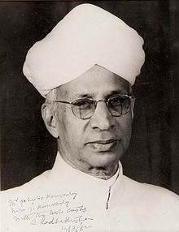
Teachers
“Teaching is not a profession but a mission”. He further said that
“the very best minds in the country should be teachers”.
Dr Sarvepalli Radhakrishnan

Slide 17
Faculty Development
Focus: Faculty enrichment
  Induction Training for all Newly recruited Faculty:
    Awareness about emerging developments
    Equip with science and art of teaching
    Technology integration, e-learning resources
    Self empowerment, motivation, team work and leadership
    Sensitization and engagement with issues such as gender, environment and sustainability, social cohesion, national integration, human values and professional ethics etc.
  Annual Refresher Training for all Teachers.
  Leadership / Management training for all educational administrators.
  HRDC, NRCs, TLC and FDC

Slide 18
Faculty Development
Action Plan and Timeline:
  Induction programmes for newly recruited faculty - Oct, 2018 onwards
  Refresher courses for in-service faculty-
  Ongoing through 66 HRDCs-2018-19
  SWAYAM courses in every discipline starting from Nov 2018
  Leadership development for academic administrators- to be launched by MHRD in Sept.2018
    Senior functionaries from Universities to join the MHRD programme
    HEIs to encourage and depute teachers for these programmes

Slide 19
Social & Industry connect
  Focus - Connect HEIs with local communities by engaging the faculty and students.
  Adoption of 05 villages by Universities and Colleges
  Customization of technologies as required by the people
  Institution – Industry interface – curriculum development, field exposure; internships, summer training, applied research, consultancy, employment etc.

Slide 20
Social & Industry Connect
Action Plan and Timeline:
Join the Unnat Bharat Abhiyan
1-2 credit course to instil Institutional social responsibility- Jan, 2019
HEIs: adoption of new course from next academic session

Slide 21
Student Progression
Focus – Alumni engagement
  Exit Programme for final year students
  Alumni Cell/ Association in HEIs
  Alumni Portal for tracking student/alumni progress
  HEIs to have a dedicated webpage/ link for alumni
  Stay connected - Social media
  Alumni Excellence Awards
  Encouraging Alumni for contributing / giving back to the institution

Slide 22
ICT based Learning tools
Focus – Technology Adoption in Education
ICT based learning tools - effective teaching-learning process
Online learning through E- PG Pathshala
MOOCs - SWAYAM
National Digital Library (NDL)
UGC Regulations for Online Programmes, 2018- Certificate, Diploma and Degree programmes allowed for eligible institutions.

Slide 23
ICT based Learning tools
Action Plan and Timeline:
All univs to adopt SWAYAM courses for credit transfer immediately
HEIs - Students and Faculty may be encouraged to use SWAYAM Platform.
UGC to develop 100 MOOCs every year

Slide 24
Promoting Quality Research
Focus – Quality Research and Innovation
Promoting Research - Socially/Locally Relevant and Nationally/Globally Significant.
Integration of research output with community well being.
Alignment of Institutional Objectives & Policies to contribute towards new knowledge & Innovation.
Nurturing culture for Quality Research, Innovation & Publications.
Faculty’s motivation and commitment.

Slide 25
Promoting Quality Research
Action plan and Timeline:
Identification of Significant Domains and Sub-domains by the core Committees –Aug- Sept, 2018.
Invitation of Online Research proposals - October, 2018.
Technology enabled evaluation & assessment of proposals for grant of research projects - March, 2019.
HEIs to establish - Incubation Centres and Research Parks Parks by 2020.
  Mentoring of young research scholars
  Support, Facilitation & Encouragement from Funding Agency & Institutional administration.

Slide 26
Mentoring of Institutions
Focus - Mentoring of weak institutions
Mentoring of non accredited institutions by a well performing (NAAC score of over 3.26) Institution
Mentoring allows :
  sharing of knowledge, information and resources
  Opportunities for research collaboration and faculty development.
  Guidance and encouragement to institutions to adopt best practices

Slide 27
Mentoring of Institutions
Action Plan and Timeline:
Design and Development of framework- Sept, 2018 (NAAC)
Connect Mentor and Mentee ;sharing of best practices – Oct, 2018 (NAAC)
Execution and Monitoring programmes – Dec, 2018 (UGC)

Slide 28

Thanks

